Slide 1
Coding & writing tips
PYthon coding style + GitHub + latex
Konstantin Volzhenin
Sorbonne university, Paris, France

Slide 2
Presentation outline
Introduction
Topic 1: PEP-8 Code Style for Python
Topic 2: Git + GitHub Introduction
Topic 3: LaTeX Introduction
Topic 4: Scientific Writing Tips
Q&A and Closing

Slide 3
Introduction
Why can’t we just simply open Python project and proceed?
Potential problems:
Bad readability can hinder collaboration and potentially lead to errors -> Unified coding style
Coordination challenges, risking loss of work and complicating teamwork -> Git
Poorly formatted documents may diminish the professional presentation of academic or technical work -> LaTeX
Ignoring scientific writing principles can obscure the clarity of research findings, obstructing effective communication within the academic community and beyond.

Slide 4
Why code style matters
Enhanced Readability: Consistent code style makes it easier for developers to understand and maintain code.
Error Prevention: Adhering to code conventions reduces the likelihood of introducing errors, fostering a more robust and reliable codebase.
Efficient Collaboration: A standardized code style facilitates collaborative efforts, allowing team members to seamlessly work together on projects.

Slide 5
Pep-8: overview
What is PEP 8?
PEP 8 stands for Python Enhancement Proposal 8, providing guidelines for code style and conventions in Python programming.
PEP 8, sometimes spelled PEP8 or PEP-8, is a document that provides guidelines and best practices on how to write Python code.
It was written in 2001 by Guido van Rossum, Barry Warsaw, and Nick Coghlan. The primary focus of PEP 8 is to improve the readability and consistency of Python code.

Slide 6
Pep-8: overview
Following PEP 8 is particularly important if you’re looking for a development job. Writing clear, readable code shows professionalism. It will tell an employer that you understand how to structure your code well.
You can find the whole document here

Slide 7
Pep-8: Examples - naming conventions
Type | Naming conventions | Examples
Function | Lowercase word or words. Separate words with underscores | function, my_function
Method |  | method, class_method
Module |  | module.py, my_module.py
Variable | Lowercase single letter, word or words. Separate words with underscores | x, var, my_variable
Class | Each word starts with a capital letter. Words are not separated | Model, MyClass
Constant | Uppercase single letter, word or words. Separate words with underscores | CONSTANT, LONG_CONSTANT
Package | Lowercase word or words. Words are not separated | package, mypackage

Slide 8
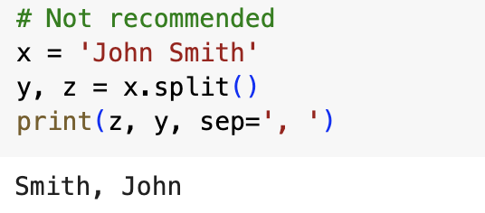
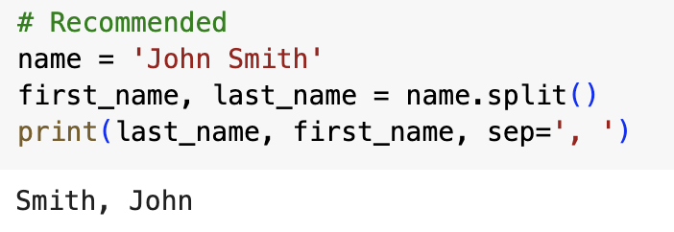
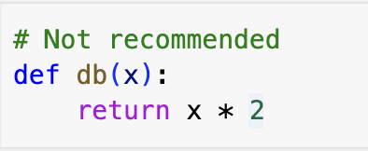
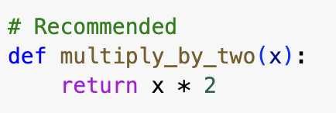
Pep-8: Examples - naming conventions

Slide 9
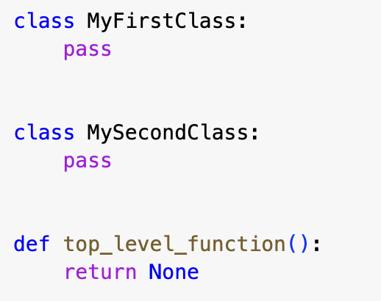
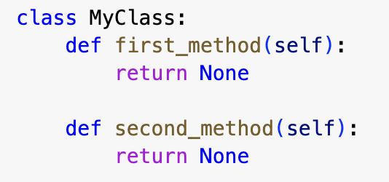
Pep-8: Examples - blanks lines for functions/classes

Slide 10
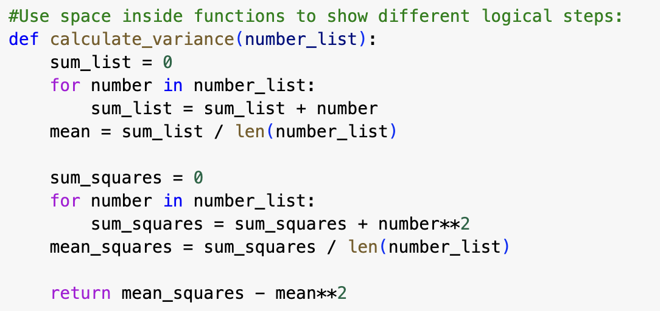
Pep-8: Examples - blanks lines for functions/classes

Slide 11
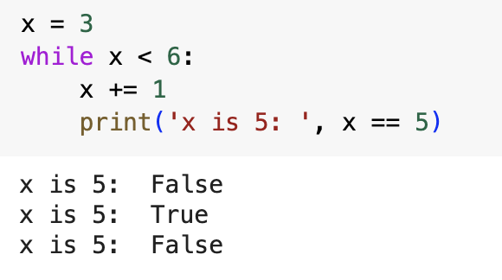
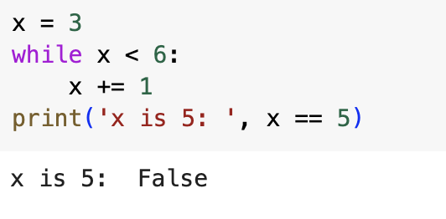
Pep-8: Examples - proper indentation
Indentation, or leading whitespace, is extremely important in Python. The indentation level of lines of code in Python determines how statements are grouped together.

Slide 12
Pep-8: Examples - proper indentation
The key indentation rules laid out by PEP 8 are the following:
Use 4 consecutive spaces to indicate indentation.
Prefer spaces over tabs.
It is better to use spaces instead of tabs when indenting code. You can adjust the settings in your text editor to output 4 spaces instead of a tab character, when you press the Tab key.

Slide 13
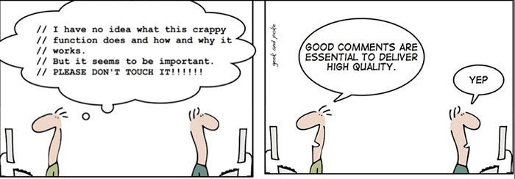
Pep-8: Examples - comments
Key points to remember when adding simple comments to your code:
Limit the line length of comments to 72 characters.
Use complete sentences, starting with a capital letter.
Make sure to update comments if you change your code.

Slide 14
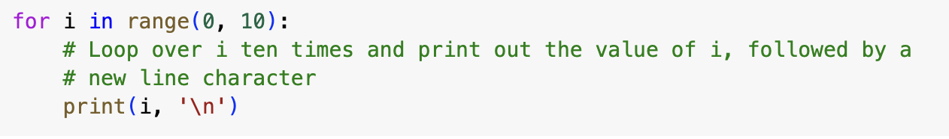
Pep-8: Examples - comments
Block comments:
Indent block comments to the same level as the code they describe.
Start each line with a # followed by a single space.
Separate paragraphs by a line containing a single #.

Slide 15
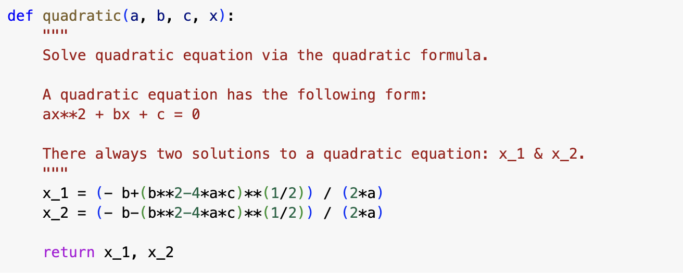
Pep-8: Examples - comments
Documentation strings, or docstrings - strings enclosed in double (") or single (') quotation marks that appear on the first line of any function, class, method, or module. You can use them to explain and document a specific block of code.

Slide 16
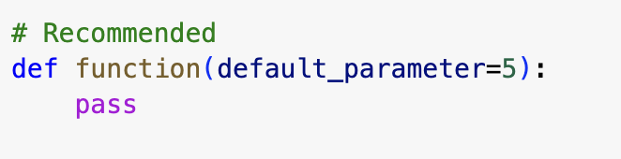
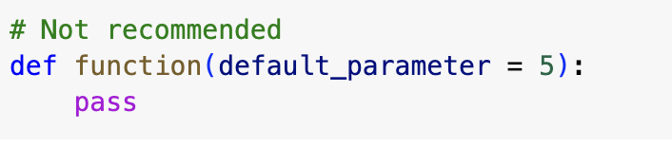
Pep-8: Examples - Whitespaces
Surround the following binary operators with a single space on either side:
Assignment operators (=, +=, -=, and so forth)
Comparisons (==, !=, >, <. >=, <=) and (is, is not, in, not in)
Booleans (and, not, or)
Exception: When = is used to assign a default value to a function argument, do not surround it with spaces.

Slide 17
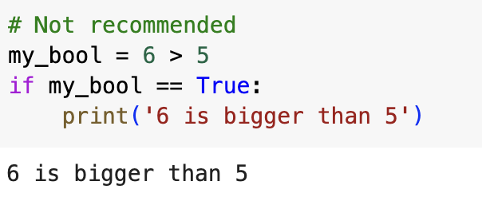
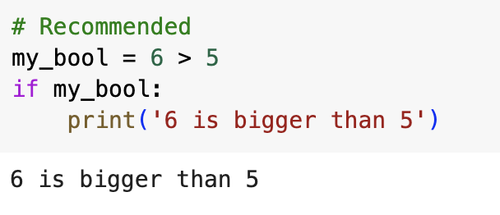
Pep-8: Examples - boolean comparison

Slide 18
Pep-8: can it be ignored?
When to ignore PEP8
Some guidelines in PEP 8 are inconvenient in the following instances:
If complying with PEP 8 would break compatibility with existing software
If code surrounding what you’re working on is inconsistent with PEP 8
If code needs to remain compatible with older versions of Python

Slide 19
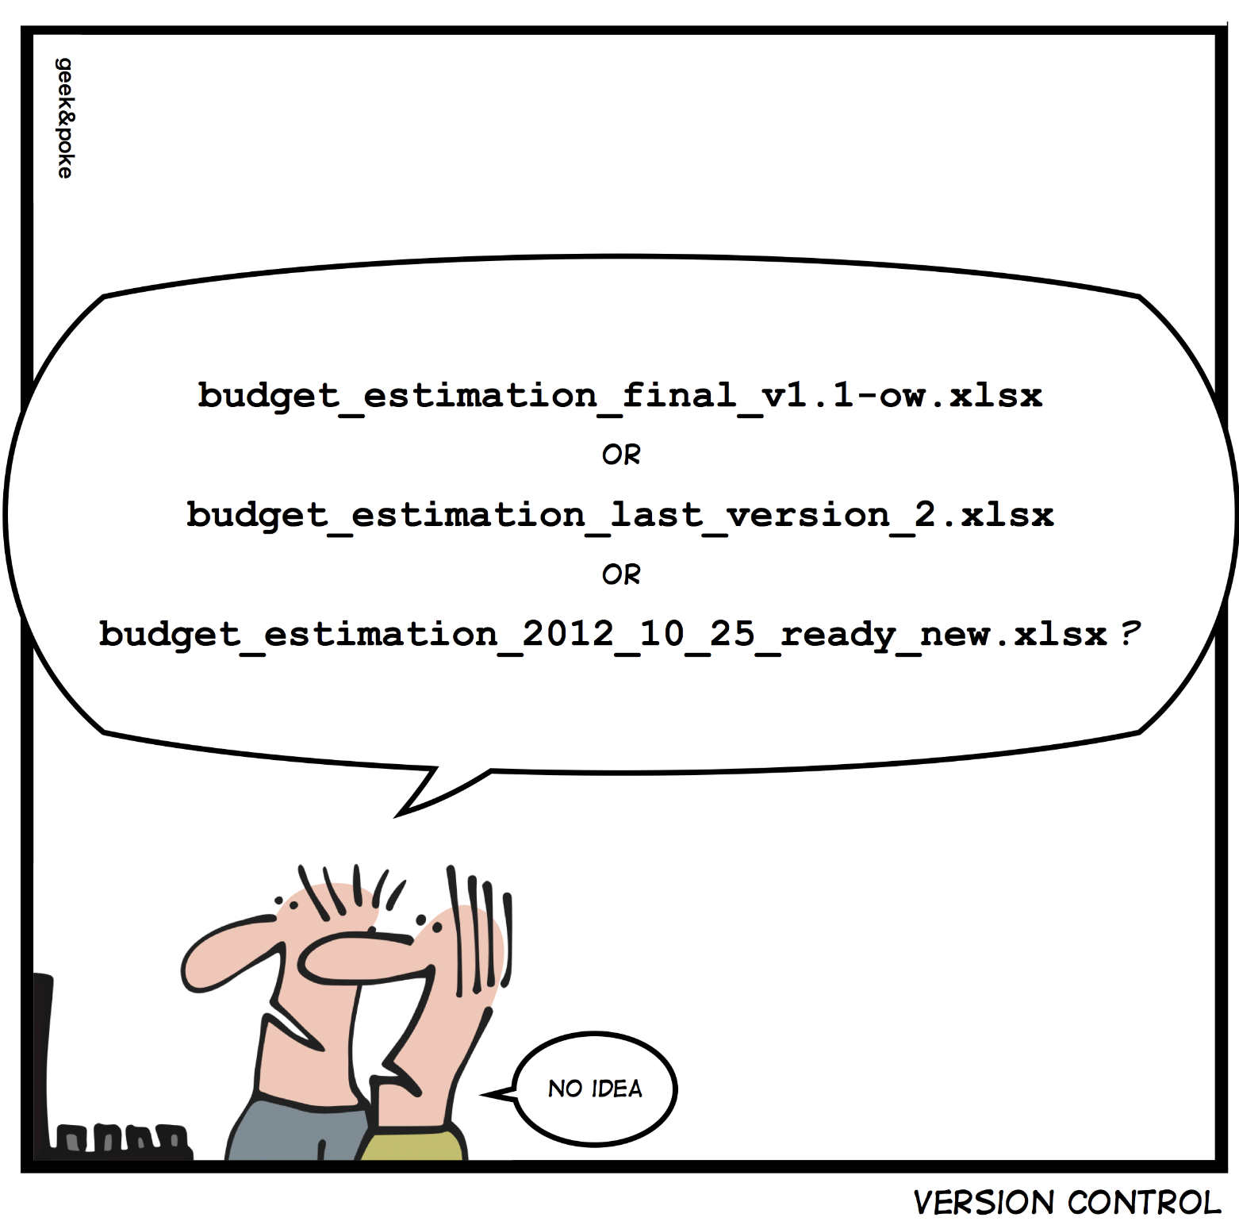
Introduction to git and GitHub
Version control - an indispensable practice in software development, facilitating the tracking of changes, collaboration among team members, and efficient project history management.

Slide 20
Introduction to git and GitHub
What is Git?
Git - distributed version control system that tracks changes in a set of computer files, commonly employed to facilitate collaboration among programmers engaged in common source code development throughout the software development process.
Git has become the most popular distributed version control system, with nearly 95% of developers reporting it as their primary version control system

Slide 21

Introduction to git and GitHub
GitHub (https://github.com/) - a developer platform that allows developers to create, store, and manage their code.
GitHub acts as a central hub for project management, enabling developers to contribute, review, and merge code seamlessly.
It uses Git software + access control, bug tracking, task management, and other useful features

Slide 22
Introduction to git and GitHub - features
Branching:
GitHub allows the creation of branches, enabling developers to work on features or bug fixes independently without affecting the main codebase.
Pull Requests:
Developers propose changes through pull requests, allowing for peer review and discussion before merging the code into the main branch.
Issue Tracking:
GitHub provides a robust issue tracking system, aiding in identifying, prioritizing, and resolving bugs or implementing new features.

Slide 23
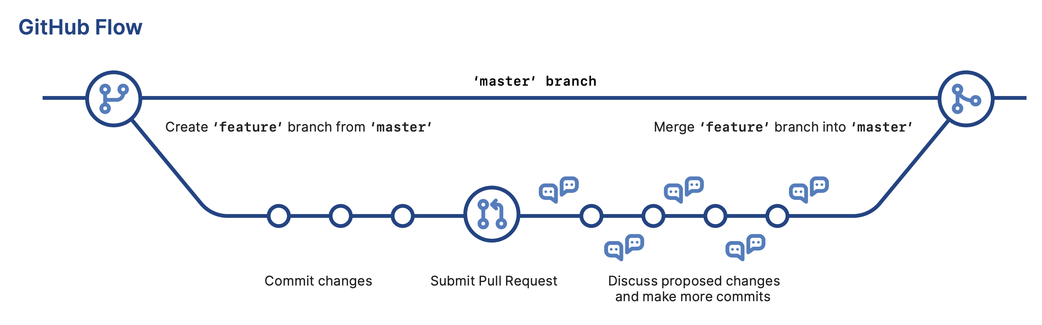
Introduction to git and GitHub - commands
GitHub Cheat Sheet can be found here

Slide 24
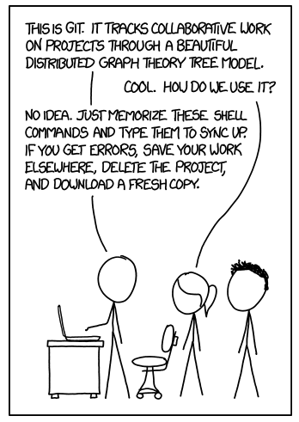
Introduction to git and GitHub - commands
Clone Repository:
git clone [repository_url]: Creates a local copy of a GitHub repository on your machine.
Create a Branch:
git branch [branch_name] and git checkout [branch_name]: Establishes and switches to a new branch for independent development.
Commit Changes:
git add . and git commit -m "Your commit message": Stages and commits changes locally.
Merge Branches:
git merge [branch_name]: Combines changes from one branch into another, often used to integrate features or bug fixes.
Push Changes:
git push origin [branch_name]: Uploads local changes to the GitHub repository.
Pull Changes:
git pull origin [branch_name]: Retrieves changes from the GitHub repository to your local machine.

Slide 25
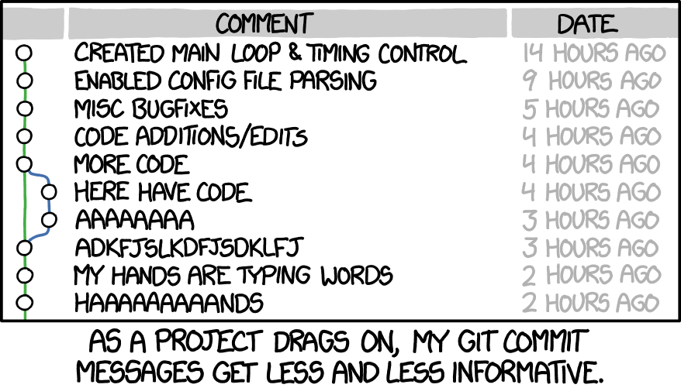
Introduction to git and GitHub - best practices
Descriptive Commit Messages:
Craft concise, yet informative commit messages to clearly convey the purpose of each change.
Regular Pull Requests:
Submit regular pull requests to keep team members informed about ongoing work and solicit feedback.
Branch Cleanup:
Delete branches after they have been merged to maintain a clean repository and avoid clutter.
Code Reviews:
Actively engage in code reviews to ensure code quality, catch errors, and share knowledge within the team.
Continuous Integration:
Integrate tools like Travis CI or GitHub Actions to automate testing and ensure code quality before merging.

Slide 26
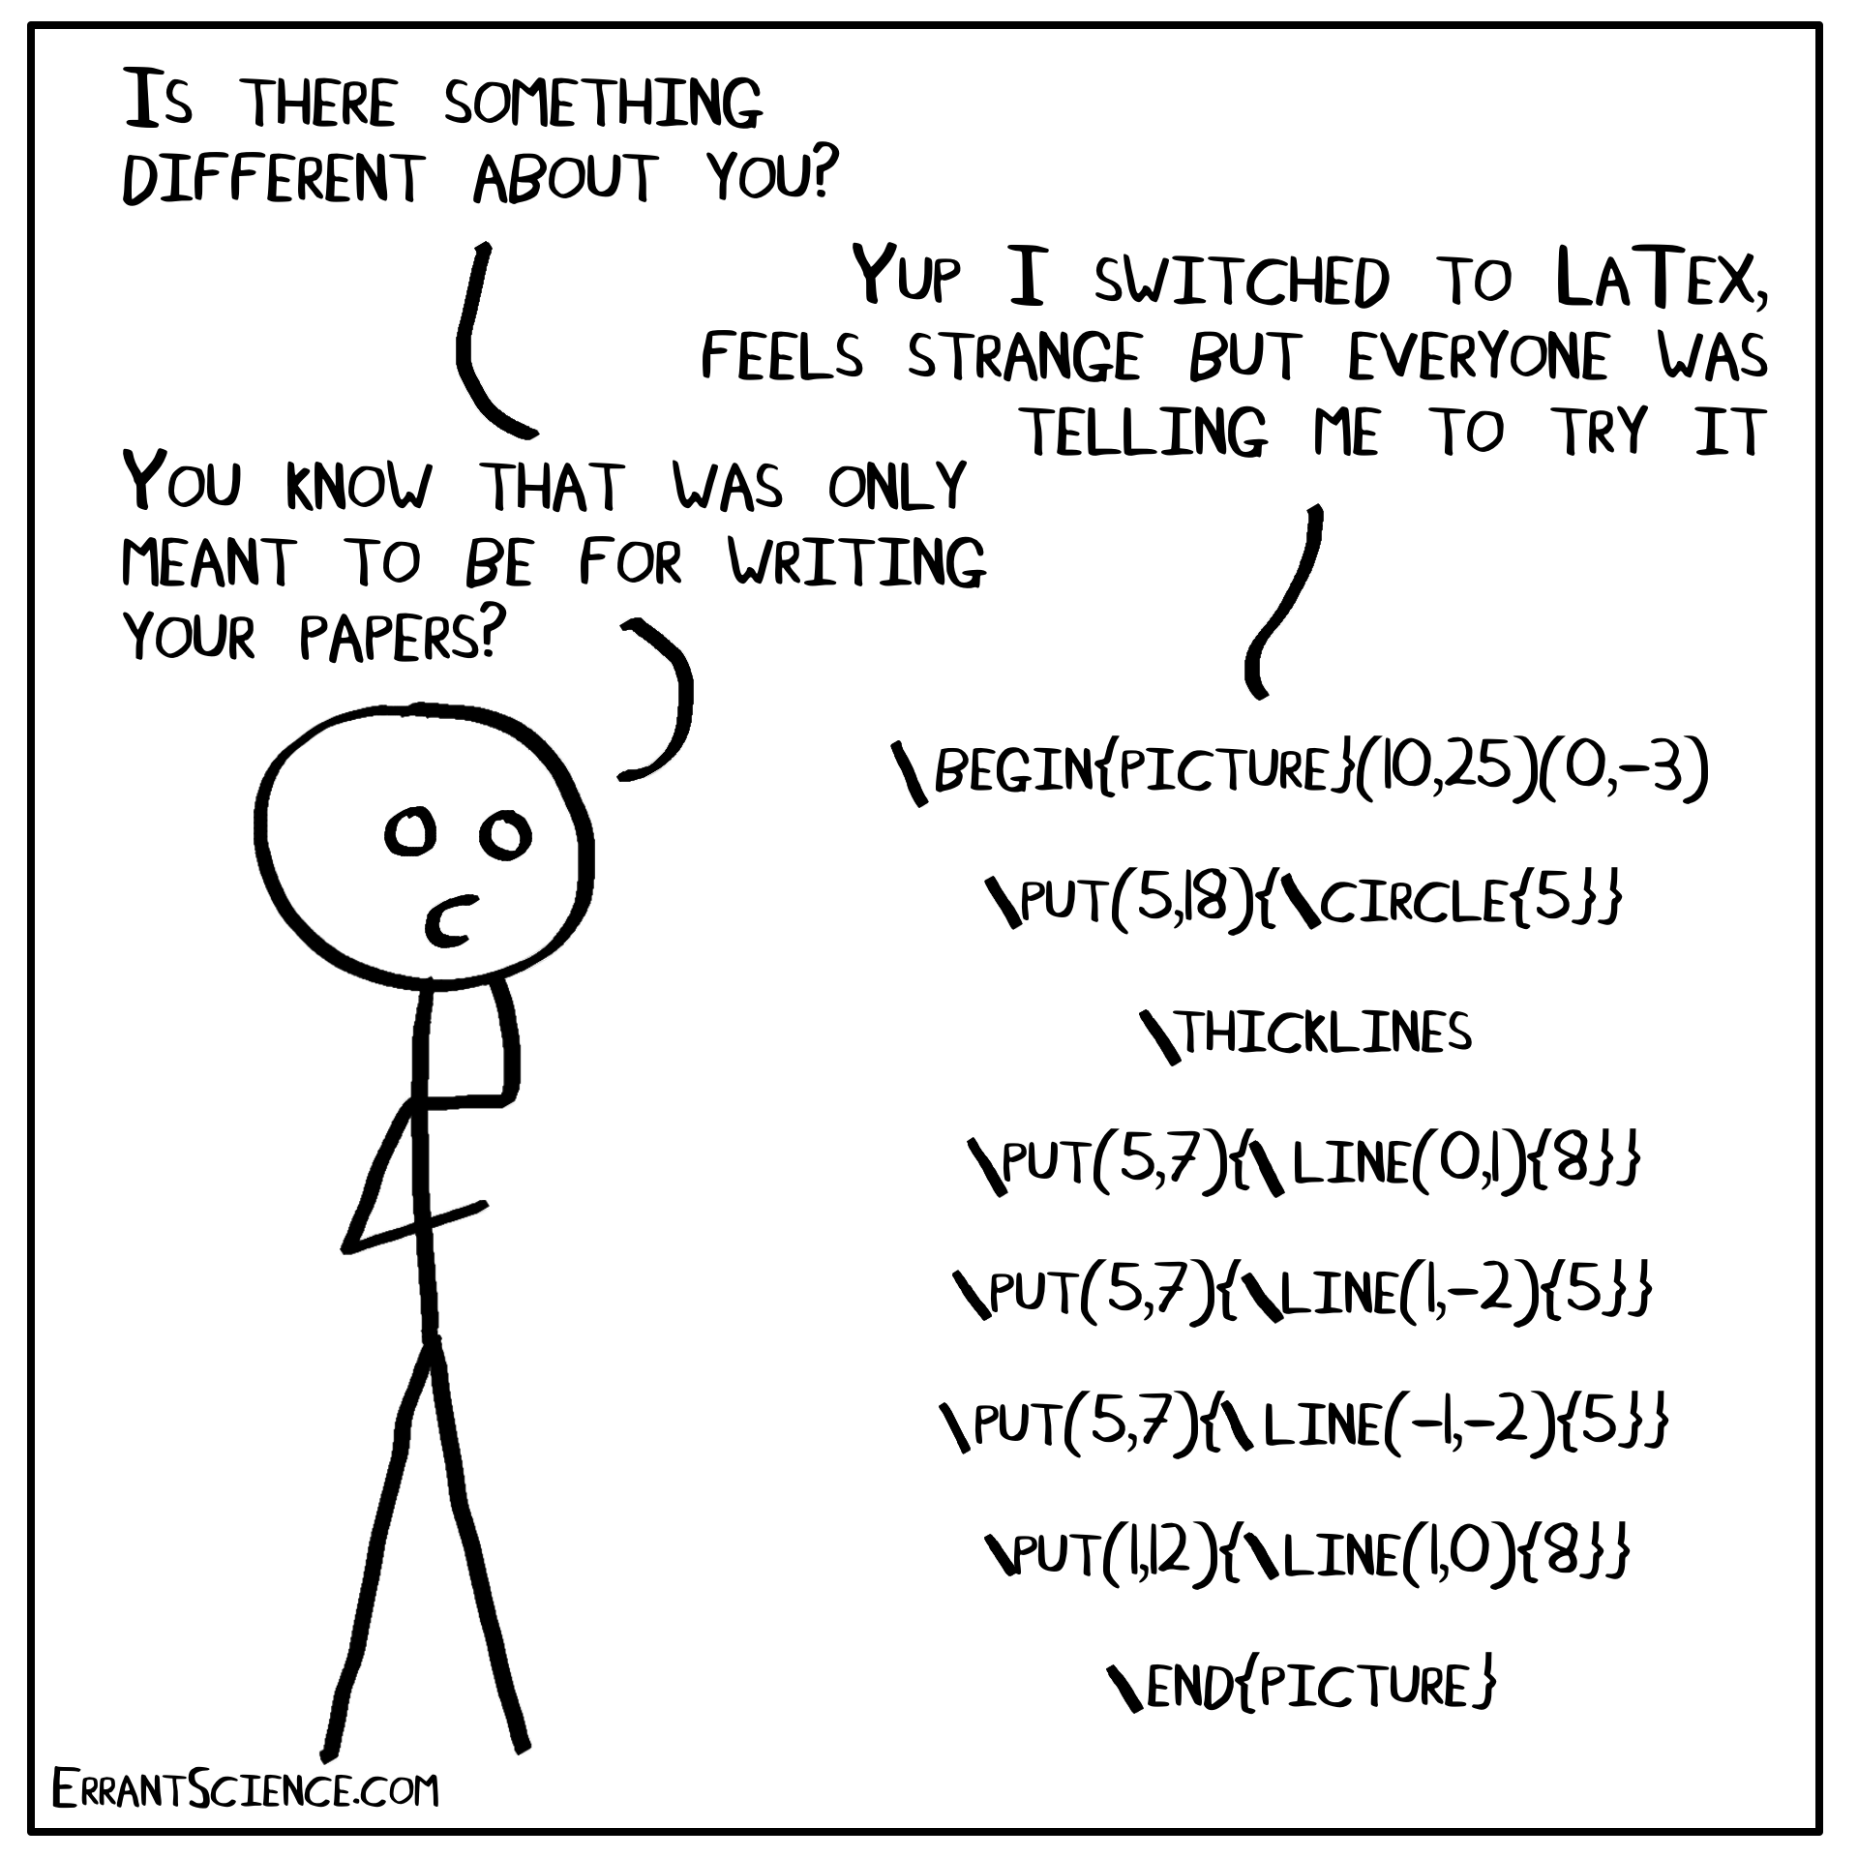
Introduction to latex
What is LaTeX?
LaTeX is a document preparation system widely used for the production of scientific and mathematical documents.
Markup Language:
Unlike WYSIWYG editors, LaTeX uses markup tags to define document structure and formatting.
Understanding LaTeX is crucial for creating professional-looking documents, especially in academic and technical contexts.

Slide 27
Introduction to latex - Advantages over WYSIWYG Editors
Precision and Consistency:
LaTeX allows for precise control over document formatting, ensuring consistent and professional-looking results.
Efficient Handling of Large Documents:
LaTeX excels in managing extensive documents, such as theses or research papers, without significant performance issues.
Automated Formatting:
With LaTeX, formatting is automated, reducing the manual effort required for tasks like table of contents, bibliographies, and citations.
Scientific and Mathematical Typesetting:
LaTeX's specialized features make it the preferred choice for scientific and mathematical documents, handling complex equations and symbols with ease.
Version Control Integration:
LaTeX documents can be easily integrated into version control systems, providing efficient collaboration and tracking changes over time.

Slide 28

Introduction to latex - overleaf - online platform
Overleaf is an online platform that provides a collaborative environment for LaTeX document preparation.
Real-Time Collaboration:
Overleaf enables multiple users to work on the same document simultaneously, facilitating real-time collaboration among authors.
Cloud-Based Storage:
Documents are stored in the cloud, allowing easy access from any device with an internet connection and ensuring data safety.
Built-In Compiler:
Overleaf features a built-in LaTeX compiler, providing instant feedback on document changes and errors.
Template Library:
Overleaf offers a comprehensive template library, streamlining the document creation process for various purposes.
Integration with Git:
Overleaf can be integrated with Git for version control, providing a seamless workflow for collaborative projects.

Slide 29
Introduction to latex - overleaf - commands
Preamble:
\documentclass{...}: Specifies the document class (e.g., article, report, book).
\usepackage{...}: Includes additional packages for extended functionality.
Document Metadata:
\title{...}, \author{...}, \date{...}: Sets the title, author, and date of the document.
\maketitle: Generates the document title based on the metadata.
Abstract:
\begin{abstract} ... \end{abstract}: Contains a concise summary of the document's content.
Sections and Subsections:
\section{...}, \subsection{...}, \subsubsection{...}: Divides the document into hierarchical sections.
Text Body:
Contains the main content of the document, organized based on the defined sections.
References and Citations:
\bibliography{...}, \cite{...}: Manages references and citations using a BibTeX file.
Figures and Tables:
\begin{figure} ... \end{figure}, \begin{table} ... \end{table}: Incorporates figures and tables into the document.

Slide 30
Introduction to latex - overleaf
Learn LaTeX in 30 minutes

Slide 31
Scientific writing tips - Clarity and Conciseness
Clarity is Key:
Choose clear and straightforward language to communicate complex ideas effectively.
Avoid unnecessary jargon or overly technical language that may confuse readers.
Conciseness Matters:
Be concise in your expressions, conveying information in the most direct and efficient way.
Trim unnecessary words and focus on delivering your message with precision.
Engage the Reader:
Use engaging language to capture the reader's attention, making your writing more compelling.
Craft sentences that flow smoothly, guiding the reader through your content.

Slide 32
Scientific writing tips - Logical Organization
Structure Your Paper:
Follow a clear structure with well-defined sections, such as Introduction, Methodology, Results, Discussion, and Conclusion.
Use headings and subheadings to guide the reader through each section.
Introduction's Role:
Clearly state the research question or objective in the introduction to provide context for the study.
Engage the reader by explaining the significance and relevance of the research.
Smooth Transitions:
Ensure smooth transitions between sections to maintain the logical flow of your paper.
Use linking sentences to connect ideas and guide the reader through your argument.

Slide 33
Scientific writing tips - importance of introduction
Clear Research Question:
State the research question or objective early in the introduction to provide a clear focus for the reader.
Clearly articulate the gap in knowledge your research aims to address.
Contextual Background:
Provide a brief background on the topic, offering context for readers unfamiliar with the subject.
Establish the importance of your research within the broader field.
Thesis Statement:
Develop a concise thesis statement that summarizes the main point of your research.
Clearly outline the goals and contributions of your study.

Slide 34
Scientific writing tips - Detailed Methodology
Clarity in Procedures:
Clearly describe the methodologies and techniques used in your research.
Use step-by-step explanations to ensure reproducibility by other researchers.
Address Variables:
Clearly define and address any variables or potential confounding factors in your methodology.
Justify the chosen methods and explain how they contribute to achieving your research goals.
Ethical Considerations:
If applicable, discuss ethical considerations and steps taken to ensure the ethical conduct of your research.
Transparency in ethical considerations builds trust with the reader.

Slide 35
Scientific writing tips - Results and Discussion
Present Results Clearly:
Use tables, graphs, or figures.
Use descriptive text to explain the significance of each result.
Link Results to Objectives:
Explicitly connect each result to the research objectives stated in the introduction.
Discuss how the results contribute to addressing the research question.
Interpretation and Analysis:
Provide a thorough interpretation of the results in the discussion section.
Analyze patterns, trends, and relationships observed in the data.

Slide 36
Scientific writing tips - Concise Conclusion
Summarize Key Findings:
Revisit the research question and highlight how your study addresses it.
Highlight Significance:
Emphasize the significance of your findings in the broader context of the field.
Discuss any implications for future research or applications.
Avoid Introducing New Information:
The conclusion is not the place for new information; focus on summarizing existing content.
Keep the conclusion directly related to the research conducted.

Slide 37
Thank you!

